Slide 1
Group Presentations
Bringing ML to the Classroom
Notes:
This is our last lesson in our introduction to Machine Learning. You are going to apply in groups what you have learned and your own interests to prepare a short presentation on an application of machine learning. You will then deliver these mini-presentations before the end of the lesson.

Slide 2
Goal
Identify a potential machine learning application
Synthesize what you have learned to create an ML project pitch.
Notes:
Explain the goal of the group presentations.

Slide 3
Starter: Visual Thinking

Slide 4
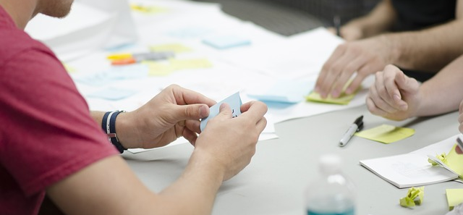

Visual Thinking
Use post-its to :
write an inspiring word, phrase, statement, or fact about ML
draw a picture or diagram relating to Machine Learning
share a potential application for ML
Fill-up as many as you can!
Notes:
[Go through the instructions on the slide and ask if there are any clarifying questions. Provide 3-5 minutes for this task]
Image from https://pixabay.com/photos/startup-start-up-people-593343/ Pixabay License Free for commercial use No attribution required

Slide 5

Visual Thinking
Walk around and review the notes.
Organize the post-its into groups and by similarities.
Notes:
What I now need you to do is to come to this wall/table and start organising your post-its. You have the freedom to put your wherever you see fit, and you are allowed to move other's notes.
[Learners are going to work together to organize the notes and review what others have written. Ask if there are any clarifying questions. Provide 5 minutes for this task]
Image from https://pixabay.com/photos/startup-start-up-people-593343/ Pixabay License Free for commercial use No attribution required

Slide 6
Debrief
How did you organize the notes?
What should we label our clusters?
Which applications seemed most interesting to you?
Notes:
Challenge students decisions, ask them why they have put a post-it in a particular place to ensure they are thinking critically about it. Ask the group to produce labels for the groupings that the class have arranged.
Write down on the whiteboard or separate out the applications which seemed most interesting to the learners.

Slide 7

Propose an Idea for an application of ML
Be sure to include:
Goal/Problem statement
How this impacts/benefits users
Type of ML problem
Data needed
Concerns (privacy, bias)
Notes:
Review the list above. Each presentation should address all of these.
Learners have 20 minutes for brainstorming and creating their presentation.
Emphasize the focus should be on clarity of the idea (as opposed to a beautiful slide or catchy team name).
Organize learners into groups of 2-4
Ask which students are interested in each application from the previous discussion. Those interested in a topic should form a group.
If there are more than 3 people interested in a topic then make two groups.
Circulate the room, ensuring that all learners are making progress. Give them time updates every 5 minutes. Question and challenge their choices and ensure that they are prepared to present.
Image from https://pxhere.com/en/photo/1553361 CC0 Public Domain Free for personal and commercial use No attribution required

Slide 8
Present Your Ideas

Slide 9
Closing Discussion
Common themes
Areas we missed?
What are you interested in doing next with ML?

